Slide 1

Reverse Carry Select Adder Using Reversible Gates
Implementation and Analysis
FACULTY OF INFORMATION ENGINEERING, INFORMATICS, AND STATISTICS. DEPARTMENT OF INFORMATICS.

Slide 2
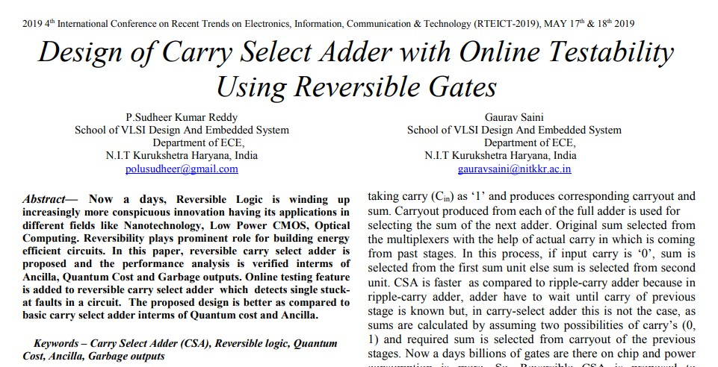






Paper Overview:
Reversible Carry Select Adder Using Reversible Gates
Pagina <number>
Notes:
Intent of the authors
Circuit Analysis

Slide 3
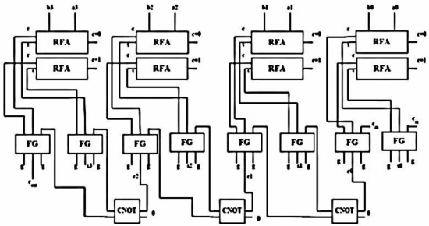
RCSA Design 1
t
Reversible Carry Select Adder Using Reversible Gates
Pagina <number>
Notes:
Authors original design
Building Block size 1
Input&Output

Slide 4
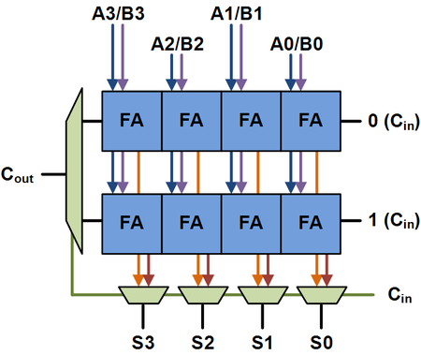






Stages Insight
CSWAP
carry
CSWAP
sum
FG
carry
FG
sum
Buffer
Reversible Carry Select Adder Using Reversible Gates
Pagina <number>
Notes:
- Classical CSA VS Quantum RCSA
MUX VS FG
FG/CSWAP
Buffer and Next Stage

Slide 5
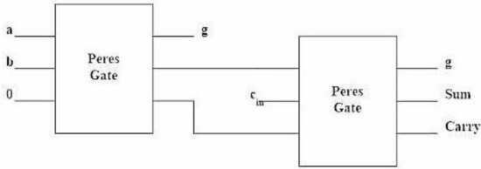
RFA Insight
Reversible Carry Select Adder Using Reversible Gates
Pagina <number>
Notes:
- Swap between the PG

Slide 6
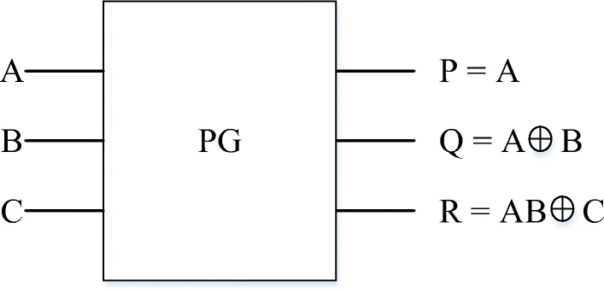
Peres Gate
Reversible Carry Select Adder Using Reversible Gates
Pagina <number>
Notes:
- Cost of PG is 4

Slide 7
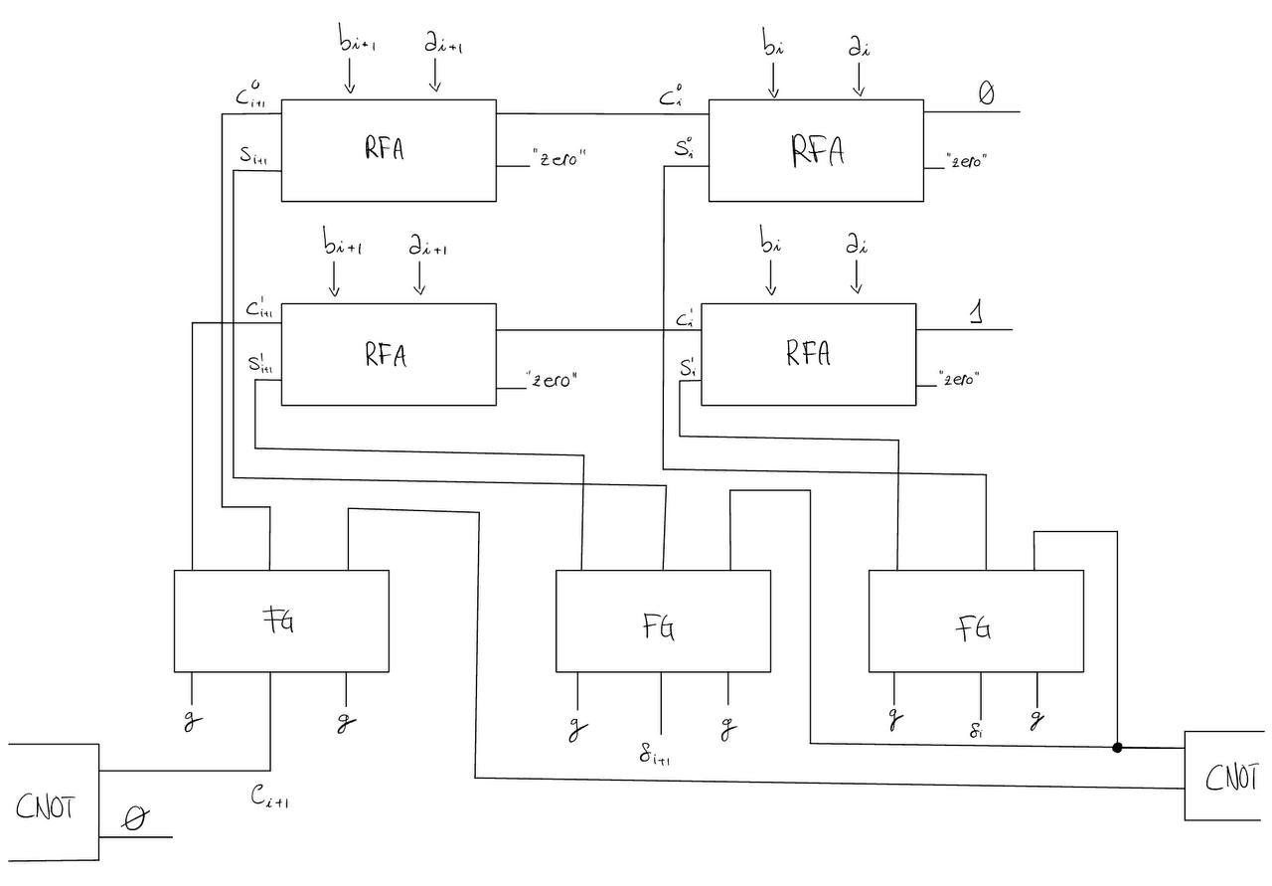

My Implementation: RCSA v1
Size 2 Building Block
Reversible Carry Select Adder Using Reversible Gates
Pagina <number>
Notes:
Intermediate RFAs receive c_out from other RFAs
FGs for the sums
FG for the c_out

Slide 8
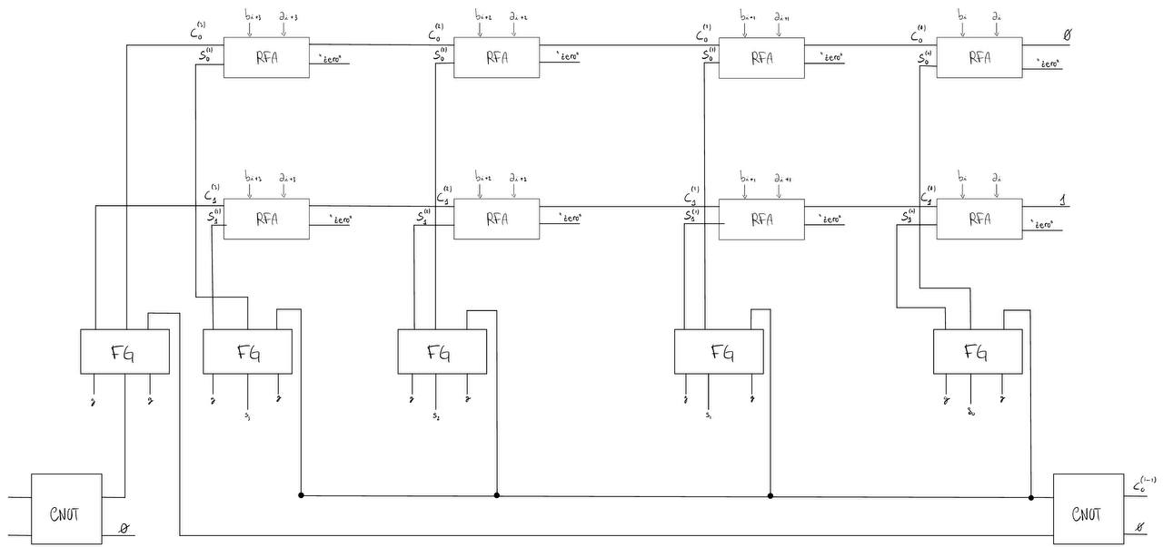


My Implementation: RCSA v2
Size 4 Building Block
Reversible Carry Select Adder Using Reversible Gates
Pagina <number>

Slide 9
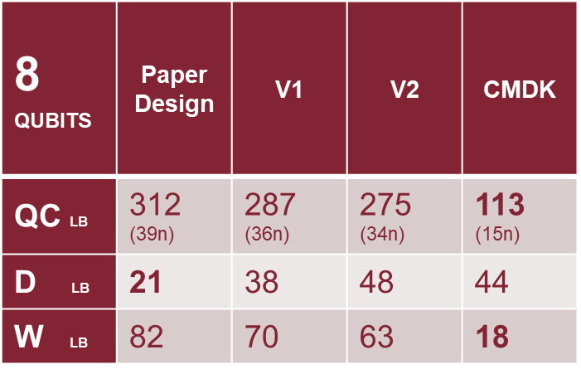
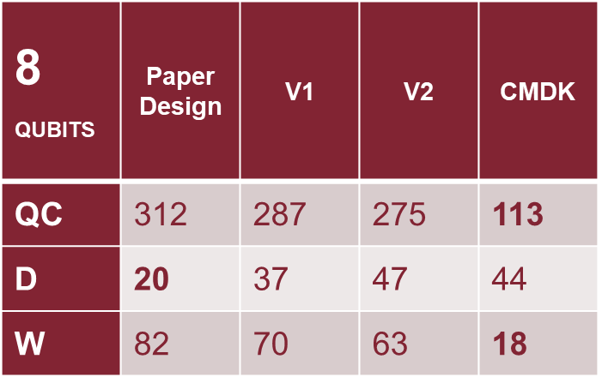

Cost Analysis
QC = Quantum Cost
D = Depth: count the # layers of Q. Gates, executed in parallel, to complete the circuit computation.
W = Width: for a Q. circuit composed from just qubits, the width is equal to the # qubits
paper design VS v1 VS v2 VS CMDK
note: D counts also the initialization and measurement layers
Table 1: NO OPTIMIZATION
Table 2: Lv. 2 OPTIMIZATION
Reversible Carry Select Adder Using Reversible Gates
Pagina <number>
Notes:
- 39n rather than 27n can be explained by the swap gate I introduced to avoid inverting ‘sum’ and ‘carry’ output lines, but then for a 8-bit RCSA is should have been 27 + 16 = 43

Slide 10











Conclusion
Because quantum gates take time to implement, the depth of a circuit roughly corresponds to the amount of time it takes the quantum computer to execute the circuit. Thus, the depth of a circuit is one important quantity used to measure if a quantum circuit can be run on a device. Since the paper RCSA presents a better depth than CMDK RCA, further investigation is worth.
Plus, further investigation should be carried out to understand why the discrepancies between the claimed and tested depth and quantum cost occur, both for Cuccaro et alia and Reddy et Saini implementations. Beware: the optimization allowed by Qiskit transpiler may vary the circuit complexity, hence when comparing the proposed solutions, set a common ground: optimize for the same backend, use the same optimization level.
Reversible Carry Select Adder Using Reversible Gates
Pagina <number>

Slide 11

THANK YOU FOR THE ATTENTION
Reversible Carry Select Adder Using Reversible Gates
Pagina <number>

